Slide 1
Mongo DB
INFO 6150
Source: Tutorial Point

Slide 2
Introduction
MongoDB is an open-source document database and leading NoSQL database
MongoDB is written in C++
MongoDB is a cross-platform, document oriented database that provides, high performance, high availability, and easy scalability
MongoDB works on concept of collection and document

Slide 3
Database/Collection/Document
Database is a physical container for collections. Each database gets its own set of files on the file system. A single MongoDB server typically has multiple databases.
Collection is a group of MongoDB documents. It is the equivalent of an RDBMS table. A collection exists within a single database. Collections do not enforce a schema. Documents within a collection can have different fields. Typically, all documents in a collection are of similar or related purpose.
A document is a set of key-value pairs. Documents have dynamic schema. Dynamic schema means that documents in the same collection do not need to have the same set of fields or structure, and common fields in a collection's documents may hold different types of data.

Slide 4
Comparison with RDBMS
RDBMS | MongoDB
Database | Database
Table | Collection
Tuple/Row | Document
column | Field
Table Join | Embedded Documents
Primary Key | Primary Key (Default key _id provided by mongodb itself)

Slide 5


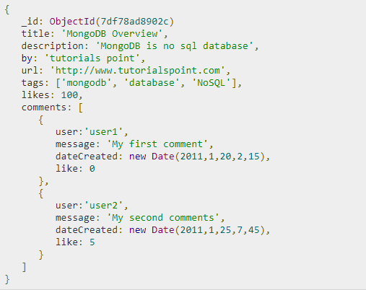

Sample Document
_id is a 12 bytes hexadecimal number which assures the uniqueness of every document. You can provide _id while inserting the document. If you don’t provide then MongoDB provides a unique id for every document. These 12 bytes first 4 bytes for the current timestamp, next 3 bytes for machine id, next 2 bytes for process id of MongoDB server and remaining 3 bytes are simple incremental VALUE.

Slide 6
Advantages of MongoDB over RDBMS
Schema less − MongoDB is a document database in which one collection holds different documents. Number of fields, content and size of the document can differ from one document to another.
Structure of a single object is clear.
No complex joins.
Deep query-ability. MongoDB supports dynamic queries on documents using a document-based query language that's nearly as powerful as SQL.
Tuning.
Ease of scale-out − MongoDB is easy to scale.
Conversion/mapping of application objects to database objects not needed.
Uses internal memory for storing the (windowed) working set, enabling faster access of data.

Slide 7
Why Use MongoDB?
Document Oriented Storage − Data is stored in the form of JSON style documents.
Index on any attribute
Replication and high availability
Auto-sharding
Rich queries
Fast in-place updates
Professional support by MongoDB

Slide 8
Where to Use MongoDB?
Big Data
Content Management and Delivery
Mobile and Social Infrastructure
User Data Management
Data Hub

Slide 9
Install MongoDB
Windows: https://www.mongodb.org/downloads
By default Mongo installs on \data\db
You can install mongo db for Linux by downloading the appropriate install
Server can be started using mongod and client can be started using mongo command line utility
Stats of the mongodb can be see by command db.stats()

Slide 10
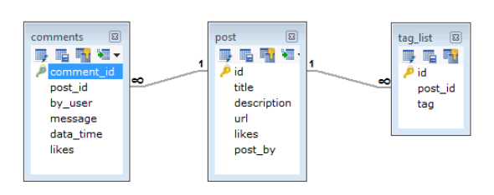
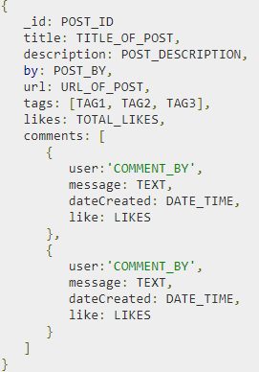
RDBMS/Mongo records

Slide 11
Mongo DB Commands
MongoDB use DATABASE_NAME is used to create database. The command will create a new database if it doesn't exist, otherwise it will return the existing database. For ex. Use mydbs
To check your currently selected database, use the command db
If you want to check your databases list, use the command show dbs.
db.movie.insert({"name":“First record"})
MongoDB db.dropDatabase() command is used to drop a existing database.

Slide 12
Mongo DB Commands
To create collections use db.createCollection("mycollection")
To show collections use show collections
In MongoDB, you don't need to create collection. MongoDB creates collection automatically, when you insert some document.
db.tutorialspoint.insert({"name" : "tutorialspoint"})
db.tutorialspoint.insert({"name" : "tutorialspoint"})

Slide 13
Datatypes
String − This is the most commonly used datatype to store the data. String in MongoDB must be UTF-8 valid.
Integer − This type is used to store a numerical value. Integer can be 32 bit or 64 bit depending upon your server.
Boolean − This type is used to store a boolean (true/ false) value.
Double − This type is used to store floating point values.
Min/ Max keys − This type is used to compare a value against the lowest and highest BSON elements.
Arrays − This type is used to store arrays or list or multiple values into one key.
Timestamp − ctimestamp. This can be handy for recording when a document has been modified or added.
Object − This datatype is used for embedded documents.
Null − This type is used to store a Null value.
Symbol − This datatype is used identically to a string; however, it's generally reserved for languages that use a specific symbol type.
Date − This datatype is used to store the current date or time in UNIX time format. You can specify your own date time by creating object of Date and passing day, month, year into it.
Object ID − This datatype is used to store the document’s ID.
Binary data − This datatype is used to store binary data.
Code − This datatype is used to store JavaScript code into the document.
Regular expression − This datatype is used to store regular expression.

Slide 14
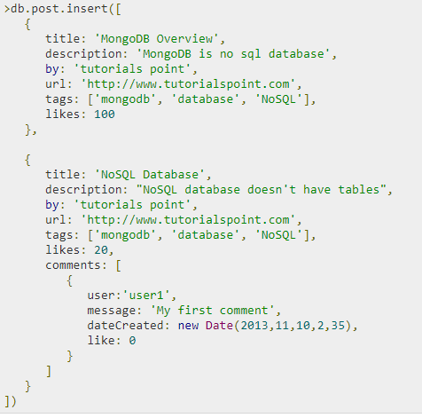
Insert into database
To insert the document you can use db.post.save(document) also. If you don't specify _id in the document then save() method will work same as insert() method. If you specify _id then it will replace whole data of document containing _id as specified in save() method.

Slide 15
Query Data
To query data from MongoDB collection, you need to use MongoDB's find()method.
db.COLLECTION_NAME.find()
To display the results in a formatted way, you can use pretty() method.
db.mycol.find({$and:[{"by":"tutorials point"},{"title": "MongoDB Overview"}]}).pretty()
db.mycol.find({$or:[{"by":"tutorials point"},{"title": "MongoDB Overview"}]}).pretty()
db.mycol.find({"likes": {$gt:10}, $or: [{"by": "tutorials point"},
{"title": "MongoDB Overview"}]}).pretty()

Slide 16
Update Data
MongoDB's update() and save() methods are used to update document into a collection. The update() method updates the values in the existing document while the save() method replaces the existing document with the document passed in save() method.
>db.mycol.update({'title':'MongoDB Overview'},{$set:{'title':'New MongoDB Tutorial'}})
>db.mycol.find()

Slide 17
Delete Data
MongoDB's remove() method is used to remove a document from the collection.
db.COLLECTION_NAME.remove(DELLETION_CRITTERIA)
db.mycol.remove({'title':'MongoDB Overview'})

